Slide 1
Console Pinouts
Ludovico Stevens

Slide 2
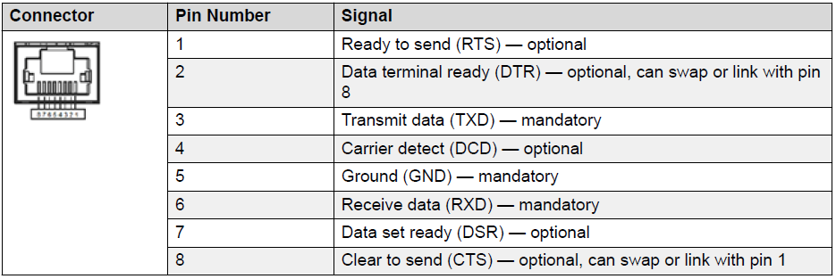
PC (DTE) DB9 pinout
to VSP, ERS, XOS, etc..
Switch (VSP, ERS, XOS, etc..) pinout
1 | DCD | data carrier detect
purple
1 | RTS | optional
2 | RXD | receive data
orange
2 | DTR | optional
3 | TXD | transmit data
black
3 | TXD | mandatory
4 | DTR | data terminal ready
red
4 | DCD | optional
5 | GND | signal ground
green
5 | GND | mandatory
6 | DSR | data set ready
yellow
6 | RXD | mandatory
7 | RTS | request to send
grey
7 | DSR | optional
8 | CTS | clear to send
white
8 | CTS | optional
9 | RI | ring indicator

Slide 3
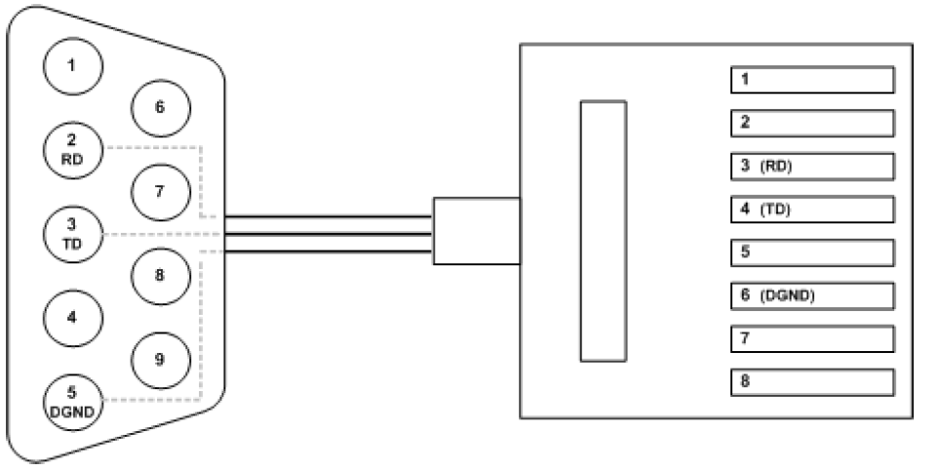
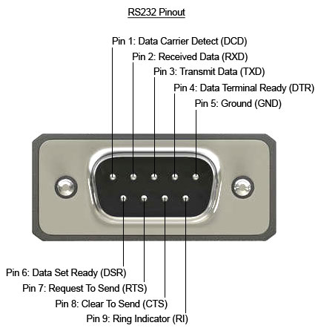
PC (DTE) DB9 pinout
to ISW (115200 baud only!)
ISW pinout
1 | DCD | data carrier detect
purple
1
2 | RXD | receive data
orange
2
3 | TXD | transmit data
black
3 | TXD | mandatory
4 | DTR | data terminal ready
red
4 | RXD | mandatory
5 | GND | signal ground
green
5
6 | DSR | data set ready
yellow
6 | GND | mandatory
7 | RTS | request to send
grey
7
8 | CTS | clear to send
white
8
9 | RI | ring indicator

Slide 4
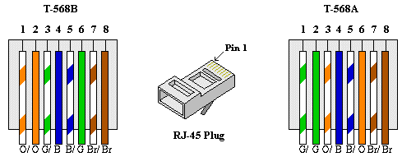
Annex
to VSP, ERS, XOS, etc..
Annex port
Switch (VSP, ERS, XOS, etc..) pinout
1 | RTS | white/green
1 | RTS | optional
2 | DTR | green
2 | DTR | optional
3 | TXD | white/orange
3 | TXD | mandatory
4 | DCD | blue
4 | DCD | optional
5 | RXD | white/blue
5 | GND | mandatory
6 | GND | orange
6 | RXD | mandatory
7 | DSR | white/brown
7 | DSR | optional
8 | CTS | brown
8 | CTS | optional

Slide 5
Lantronix SLC8000
to VSP, ERS, XOS, etc..
Lantronix port
Using default reverse (DCE) pinout
Switch (VSP, ERS, XOS, etc..) pinout
1 | CTS | white/green
1 | RTS | optional
2 | DSR | green
2 | DTR | optional
3 | RXD | white/orange
3 | TXD | mandatory
4 | GND | blue
4 | DCD | optional
5 | GND | white/blue
5 | GND | mandatory
6 | TXD | orange
6 | RXD | mandatory
7 | DTR | white/brown
7 | DSR | optional
8 | RTS | brown
8 | CTS | optional

Slide 6
Avocent ACS5000
to VSP, ERS, XOS, etc..
Avocent port
Switch (VSP, ERS, XOS, etc..) pinout
1 | RTS | white/green
1 | RTS | optional
2 | DTR | green
2 | DTR | optional
3 | TXD | white/orange
3 | TXD | mandatory
4 | GND | blue
4 | DCD | optional
5 | CTS | white/blue
5 | GND | mandatory
6 | RXD | orange
6 | RXD | mandatory
7 | DCD | white/brown
7 | DSR | optional
8 | DSR | brown
8 | CTS | optional

Slide 7
Lantronix SLC8000
to ISW
Lantronix port
Using default reverse (DCE) pinout
ISW pinout
1 | CTS | white/green
1
2 | DSR | green
2
3 | RXD | white/orange
3 | TXD | mandatory
4 | GND | blue
4 | RXD | mandatory
5 | GND | white/blue
5
6 | TXD | orange
6 | GND | mandatory
7 | DTR | white/brown
7
8 | RTS | brown
8

Slide 8
Thank You

